Slide 1
Diversity driven Attention Model for Query-based Abstractive Summarization
Preksha Nema*, Mitesh Khapra*, Anirban Laha*#, Balaraman Ravindran*
*Indian Institute of Technology Madras, India.
#IBM Research India.

Slide 2
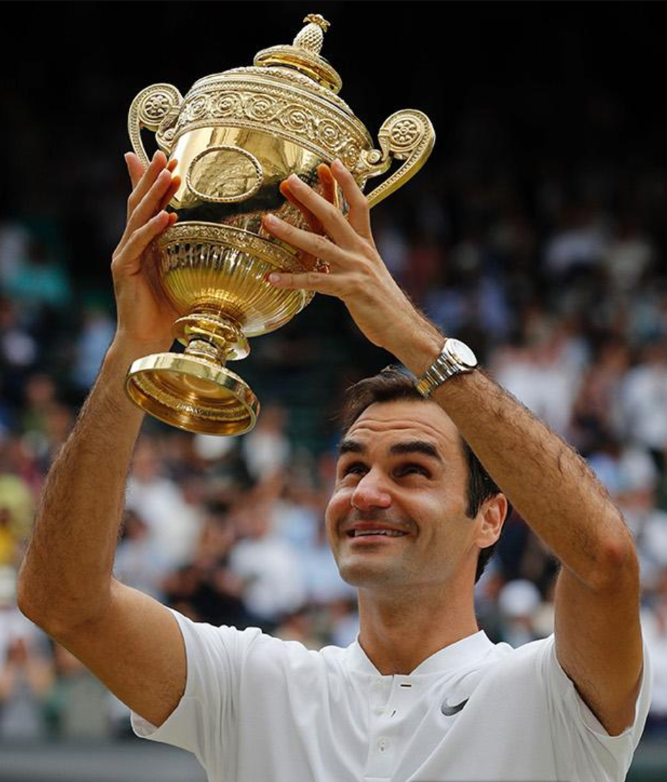
Extractive vs Abstractive Summarization
Roger Federer wins a record eighth men’s singles title at Wimbledon on Sunday.
He defeated Marin Cilic in straight sets with 6-3, 6-1, 6-4. Cilic appeared to struggle
with a foot injury but the Swiss was in imperious form on Centre Court, winning
the final in one hour and 41 minutes. It is Federer’s 19th grand slam title
and his second of 2017 following victory at the Australian Open in January.
Extractive Summarization
Roger Federer wins a record eighth men’s
singles title at Wimbledon on Sunday.
Abstractive Summarization
Roger Federer wins record eighth
Wimbledon title against Marin Cilic.

Slide 3
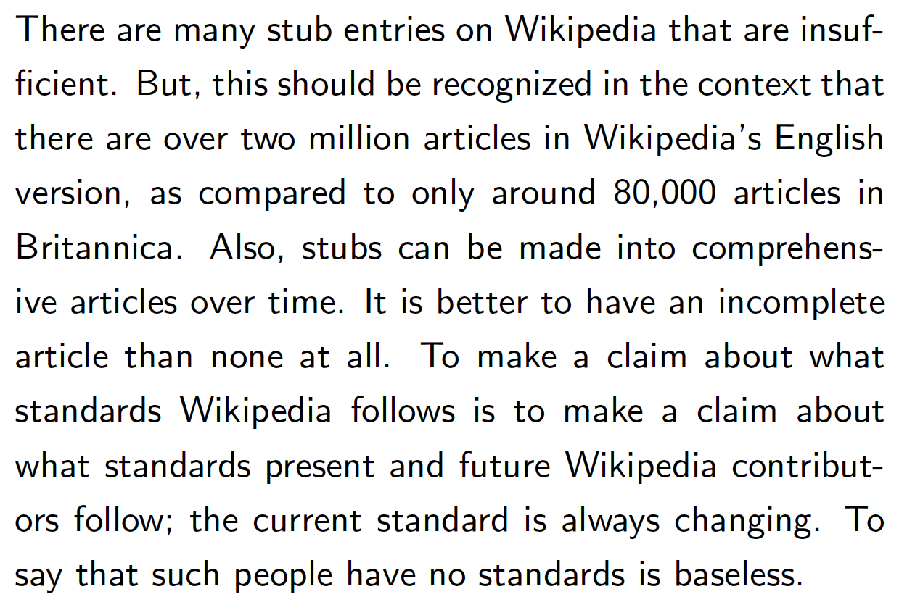
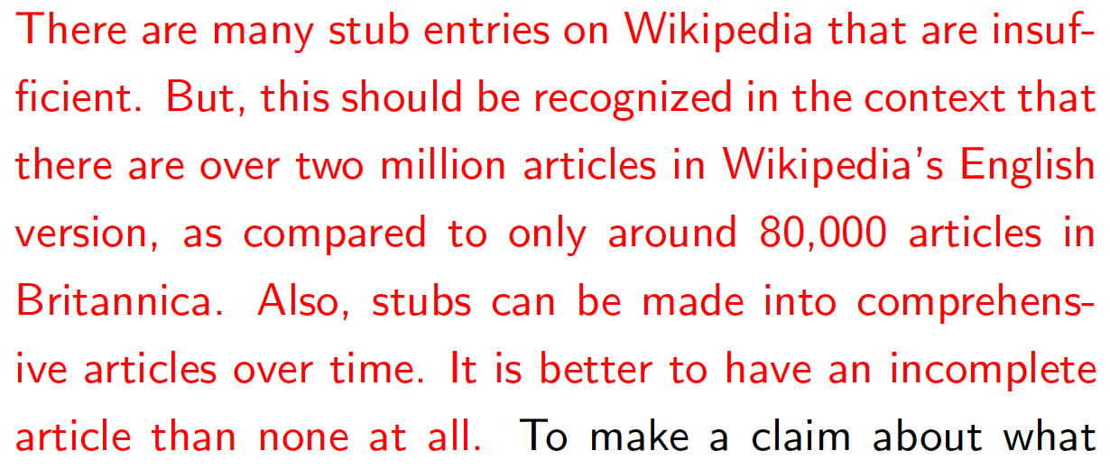
Query-based Abstractive Summarization

Slide 4
Recap : Attention Mechanism

Slide 5
Encoder-Decoder Approaches
Roger Federer won the Wimbledon
Roger
Roger Federer
ENCODER
Output
Encoder States
Decoder States
Word Embedding
DECODER
SOURCE: Roger Federer wins a record eighth men’s singles title at Wimbledon on Sunday.

Slide 6
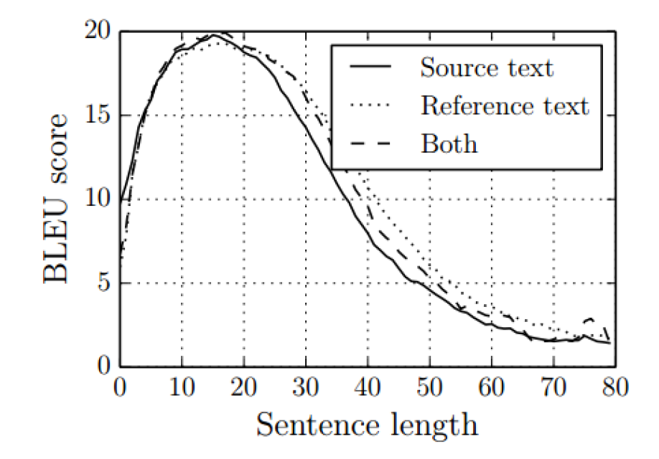
Limitation of Encoder-Decoder Approaches [Cho et. al. 2014]
Reported BLEU scores for machine translation task for sentences of a given length
Key Limitation: Performance of the model suffers as the length of the sentences increases

Slide 7
Encoder-Decoder With Attention [Bahdanau et. al. 2015]
Roger Federer
Roger Federer won
Roger Federer won the Wimbledon
Roger
Attention Mechanism
Output
ENCODER
Encoder States
Decoder States
Word Embedding
DECODER
SOURCE: Roger Federer wins a record eighth men’s singles title at Wimbledon on Sunday.

Slide 8
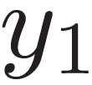
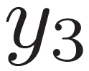
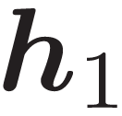
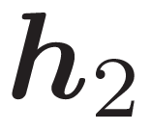
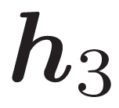
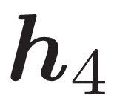
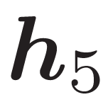
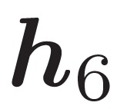
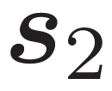
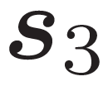
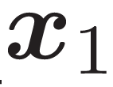
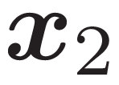
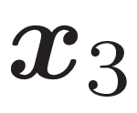
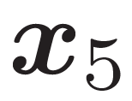
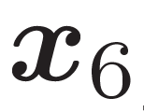
Encoder-Decoder With Attention [Bahdanau et. al. 2015]
Federer won Aus Open again
Sparse Attention Mechanism
Output
ENCODER
Encoder States
Decoder States
DECODER
Word Embedding
SOURCE: Roger Federer wins a record equaling sixth men’s singles title at Aus Open on Sunday.

Slide 9
Limitation of models described so far… [Baskaran et. al. 2016]
Key Limitation: The models described so far tend to repeat phrases in the output

Slide 10
PROPOSED Solution

Slide 11
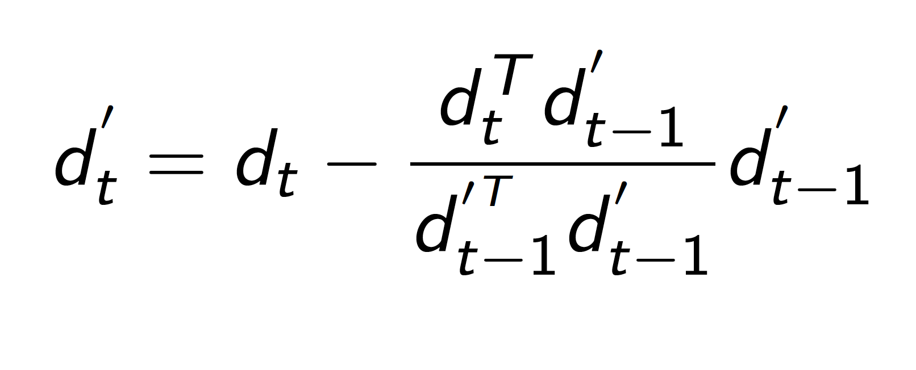
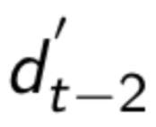
Solution Approach 1 (D1)
Making context vector orthogonal
Context vector orthogonal to . Hence DIFFERENT.
need not be orthogonal to .

Slide 12
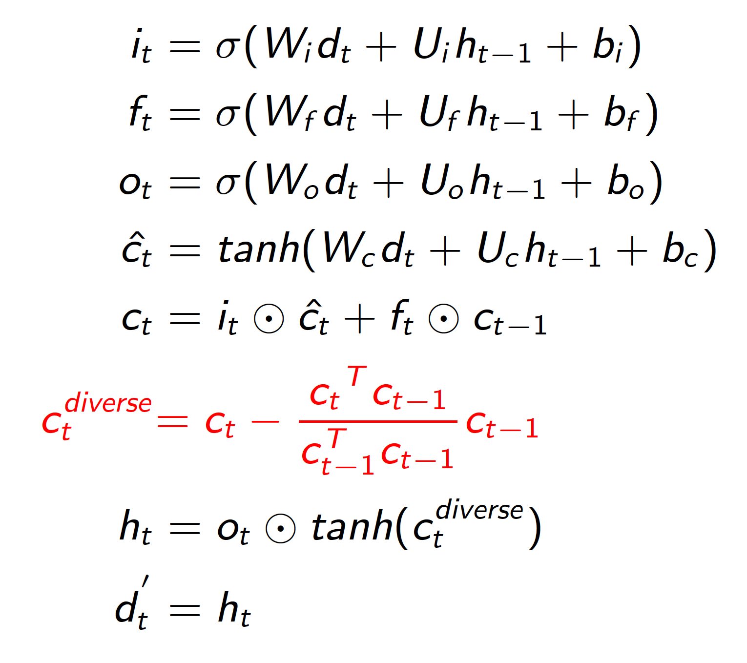
Solution Approach 2 (D2)
Introduce a modified Diversity LSTM cell.
Cell content orthogonalized to previous time step.
Context vector output of the cell.
Standard LSTM
equations
Diversity

Slide 13
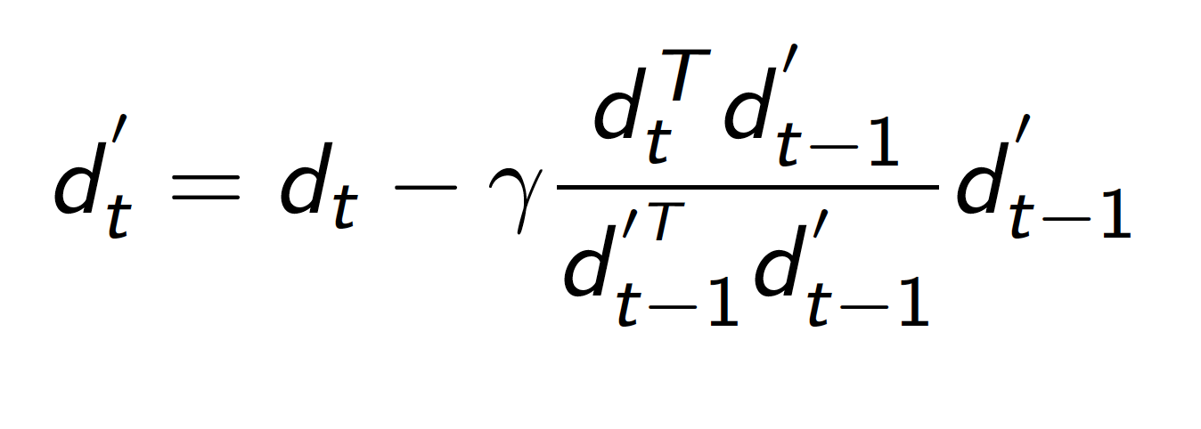
Removing hard constraints
D1 → SD1
D2 → SD2

Slide 14
Illustration
Diversity Cell
Roger Federer won the Wimbledon
Attention Mechanism
Output
ENCODER
Encoder States
Decoder States
DECODER
Word Embedding
SOURCE: Roger Federer wins a record eighth men’s singles title at Wimbledon on Sunday.

Slide 15
Model for Query-based Abstractive Summarization

Slide 16
DOCUMENT: Roger Federer wins a record eighth men’s singles title at Wimbledon on Sunday. He defeated Marin Cilic in straight sets with 6-3, 6-1, 6-4.
DOCUMENT ENCODER
OUTPUT
Word Embedding
Encoder States
Federer won in straight sets
Federer won in straight
Output
Document Attention
Diversity Cell
Decoder States
DECODER
Query Attention
Query States
QUERY: Margin of victory
Word Embeddings
QUERY ENCODER

Slide 17
Available Datasets
Various datasets for Abstractive Summarization
Dataset for Query-Based Extractive Summarization

Slide 18
NEW DATASET!!!!!

Slide 19
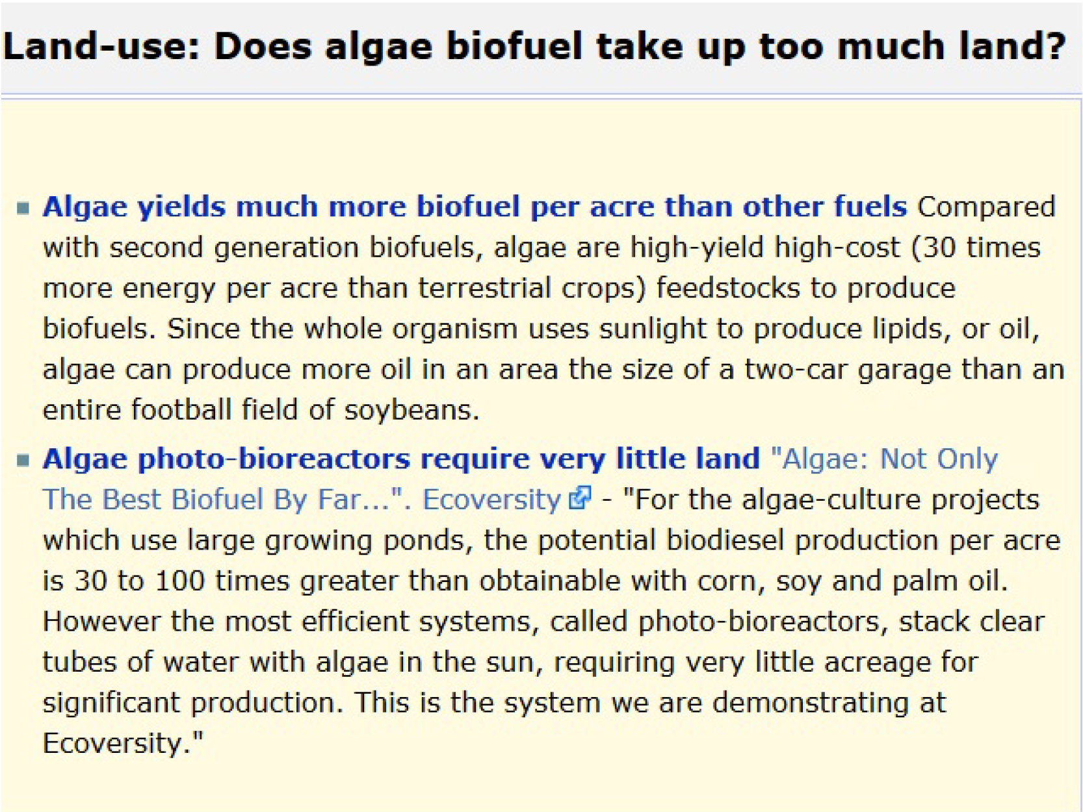
Data Creation
Crawled from Debatepedia: an encyclopedia of pro and con arguments
Each debate topic has a set of queries associated with it
Each query has a set of documents and an abstractive summary associated with each document
Triples (12695):
(Query, Document, Summary)
Documents and summaries for a given query

Slide 20
Experimental Results
Models | ROUGE-1 | ROUGE-2 | ROUGE-L
Vanilla e-a-d | 13.73 | 2.06 | 12.84
Query_{enc} | 20.87 | 3.39 | 19.38
Query_{attn} | 29.28 | 10.24 | 28.21
B1 | 23.18 | 6.46 | 22.03
M1 [Chen et. al, 2016] | 33.06 | 13.35 | 32.17
M2 [Chen et. al, 2016] | 18.42 | 4.47 | 17.45
D1 | 33.85 | 13.65 | 32.99
SD1 | 31.36 | 11.23 | 30.5
D2 | 38.12 | 16.76 | 37.31
SD2 | 41.26 | 18.75 | 40.43

Slide 21
Anecdotal Examples
Source Text : Fuel cell critics point out that hydrogen is flammable, but so is gasoline. Unlike gasoline,
which can pool up and burn for a long time, hydrogen dissipates rapidly. Gas tanks tend to be easily
punctured, thin-walled containers, while the latest hydrogen tanks are made from Kevlar. Also, gaseous
hydrogen isn’t the only method of storage under consideration – BMW is looking at liquid storage while
other researchers are looking at chemical compound storage, such as boron pellets.
Query: safety are hydrogen fuel cell vehicles safe
Reference : hydrogen in cars is less dangerous than gasoline
Query_{att}: hydrogen is hydrogen hydrogen hydrogen fuel energy
SD1: hydrogen in cars is reduce risk than fuel
SD2: hydrogen in cars is less dangerous than gasoline

Slide 22
Anecdotal Examples
Source Text : :The basis of all animal rights should be the Golden Rule:
we should treat them as we would wish them to treat us,
were any other species in our dominant position.
Query: do animals have rights that makes eating them inappropriate
Reference: animals should be treated as we would want to be treated
Query_{att}: animals should be treated as we would protect to be treated
D1: animals should be treated as we most individual to be treated
SD1: animals should be treated as we would physically to be treated
D2: animals should be treated as we would illegal to be treated
SD2: animals should be treated as those would want to be treated

Slide 23
Key Contributions
Diversity based Attention Mechanism
Alleviates undesired repeating words/phrases.
Flexible enough to allow repetition when required.
Dataset on Query-based Abstractive Summarization
Created from Debatepedia

Slide 24
Future Work
Experiment with different NLG tasks using Diversity Model
Abstractive Summarization
NLG from Structured Data
Natural Question Generation
Image Captioning
Video Summarization

Slide 25
Thank You!

